Slide 1

Bauer Bot
Bauer Bot
By- Arfat Kamal Sahat al Ferdous Fahim
Md Saidur Rahman Tasawar Siddique

Slide 2
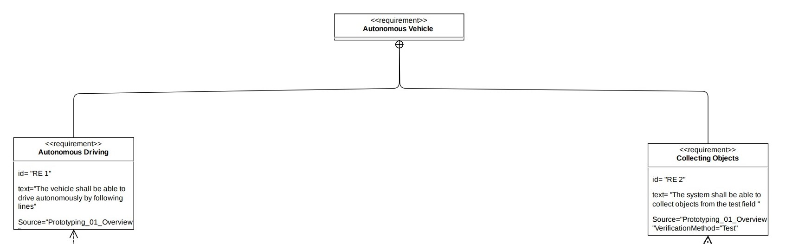
Requirement Diagram

Slide 3
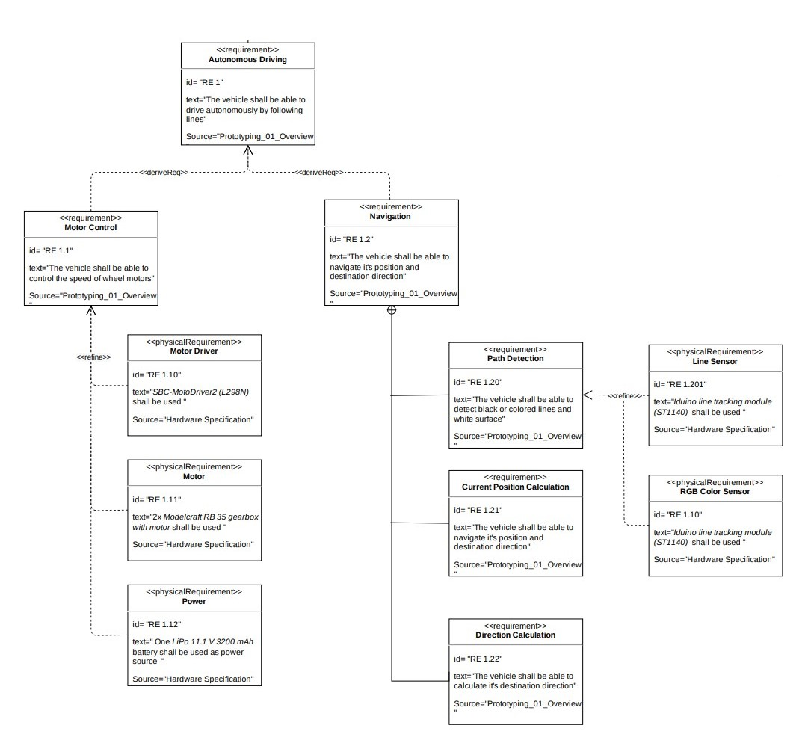
Requirement Diagram

Slide 4
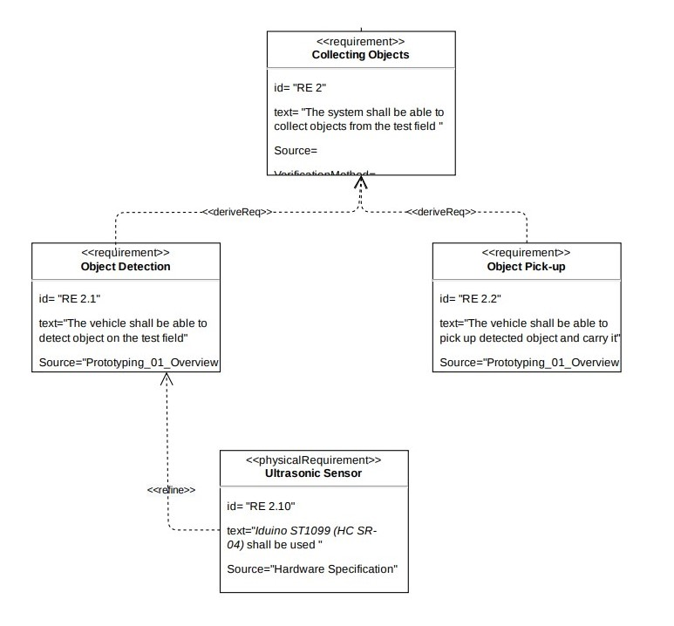
Requirement Diagram

Slide 5
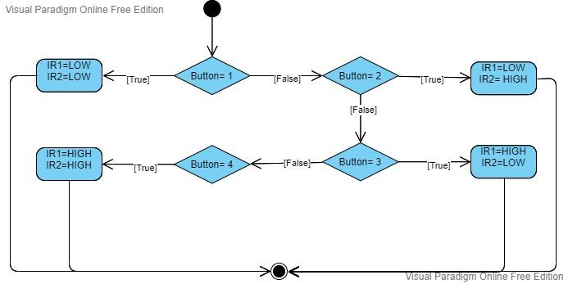
map_IRsensor()

Slide 6
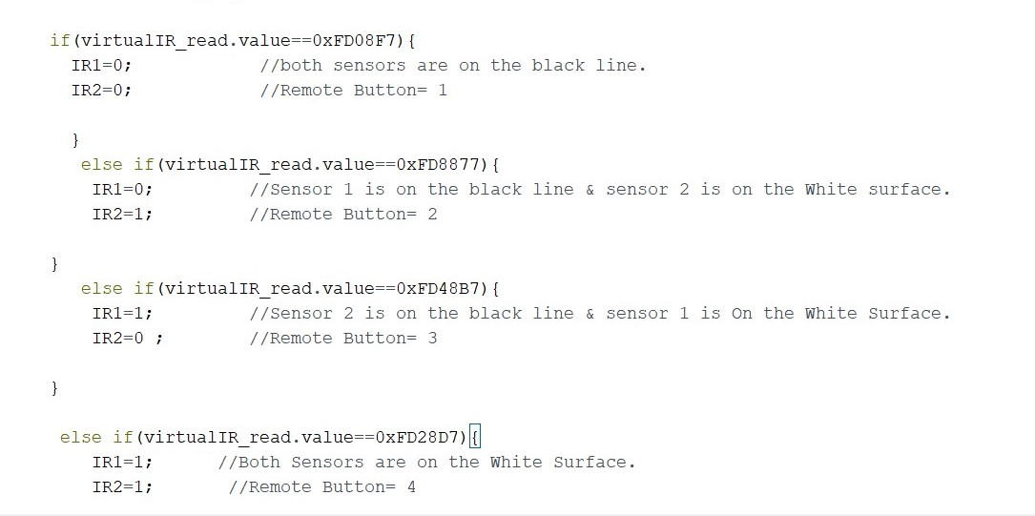
map_IRsensor()

Slide 7
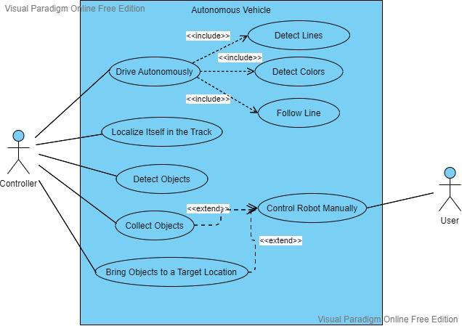
Use Case Diagram

Slide 8
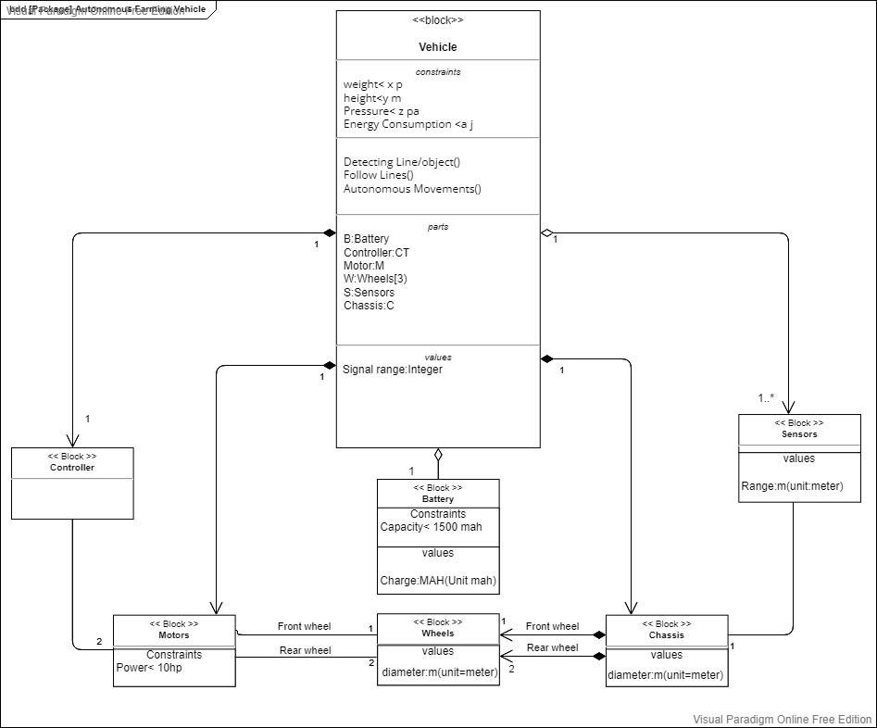
Block Definition Diagram

Slide 9
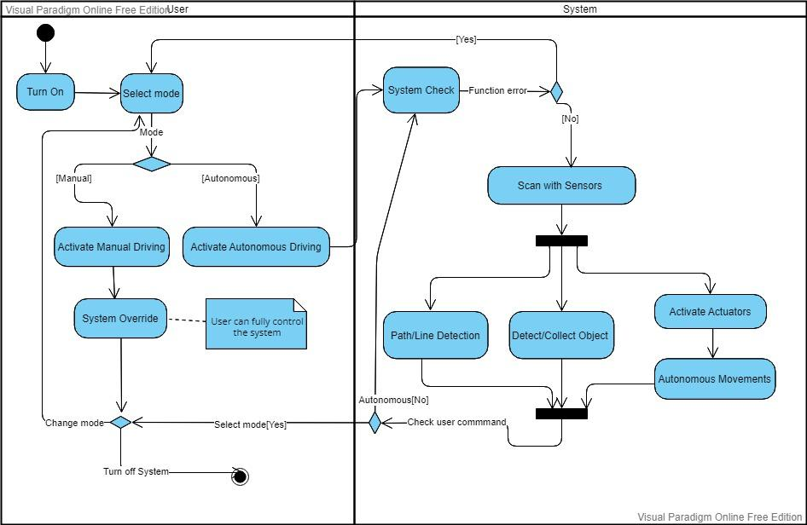
Activity Diagram

Slide 10
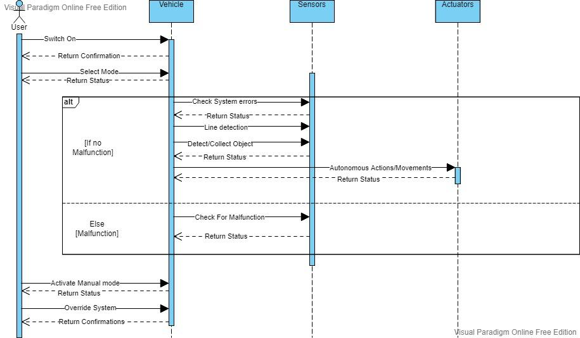
Sequence Diagram

Slide 11
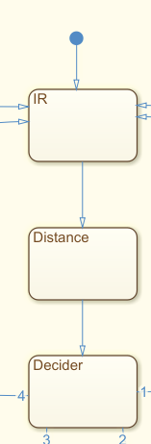
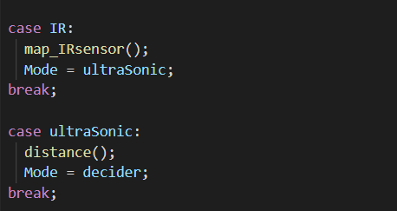

Slide 12
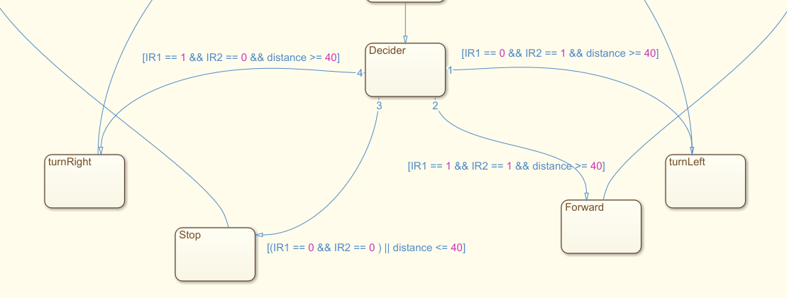

Slide 13
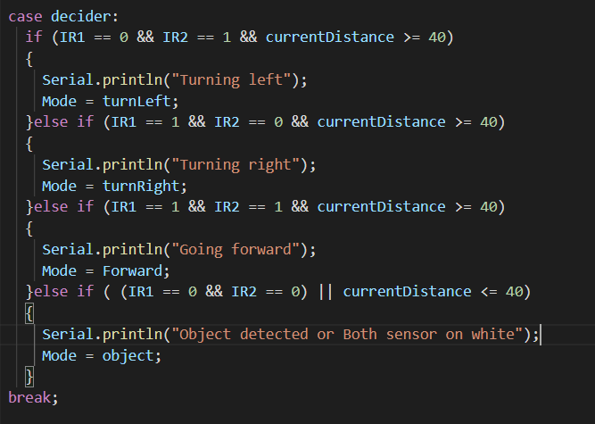

Slide 14
